Slide 1
IOT Temperature Monitoring

Slide 2
Background
Learning experience
Something to build off of
Hardware considerations
Budget

Slide 3

Why I Chose This Project
Within scope & time frame, not mechanically complex
Can be expanded upon in the future
Hardware choice
Practical for my use

Slide 4
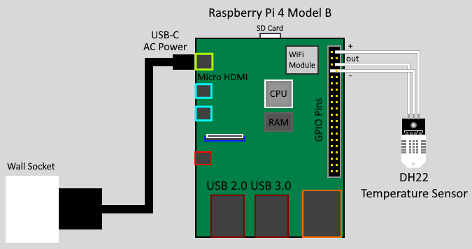
Hardware Setup
Minimal Components
Raspberry Pi 4B
DHT22 Temperature Sensor
9W Power Supply

Slide 5
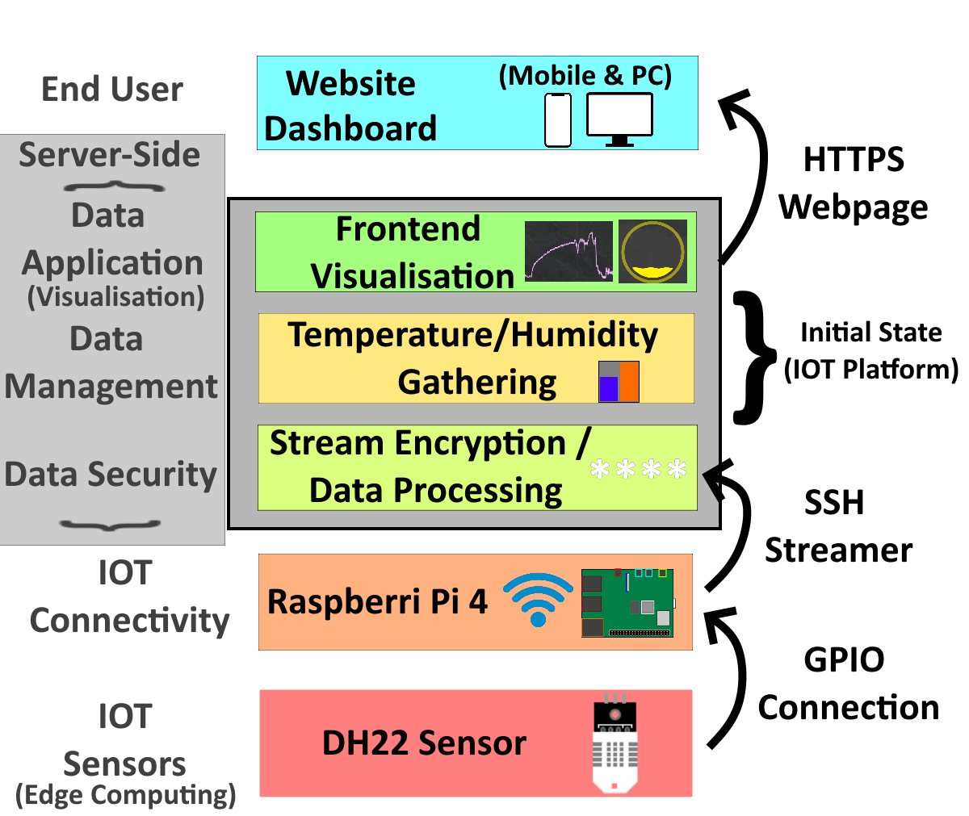
Software & Architecture
Sensing Layer (DHT22 Sensor)
IOT Hardware Platform (RPi)
IOT Hub (Initial State)
End-User Dashboard (PC & Mobile)

Slide 6
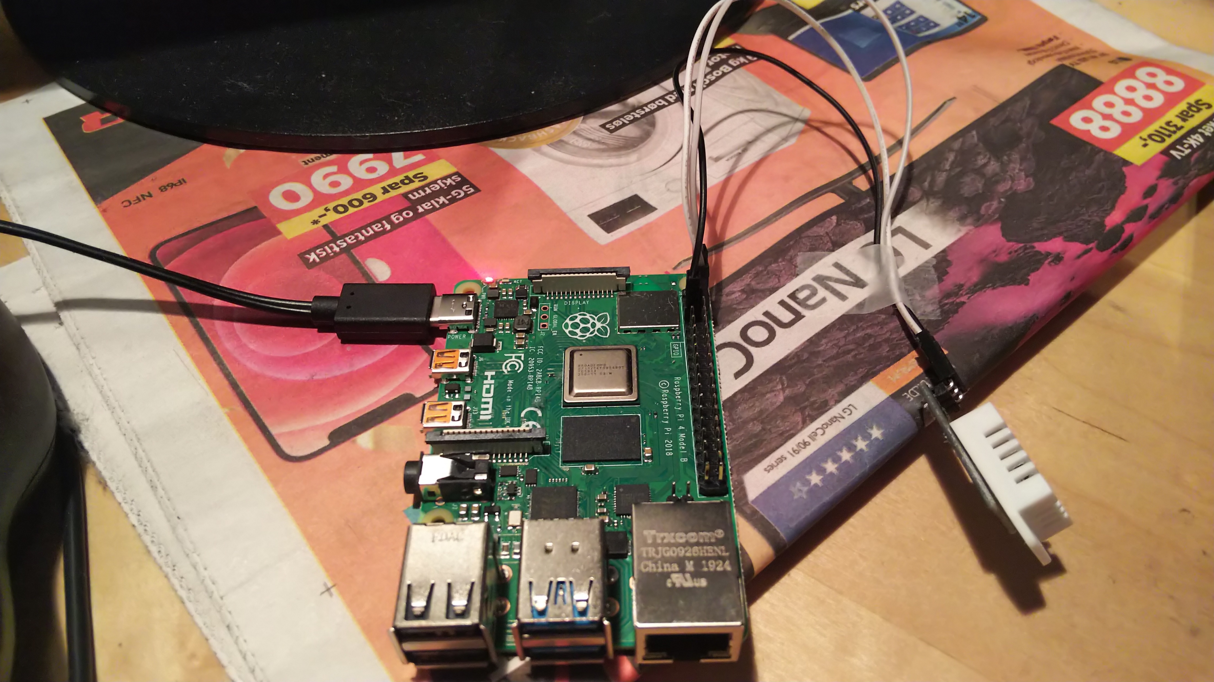
Hardware Implementation
Setting up the workstation
Wiring the sensors
Test if hardware functions (in software)

Slide 7
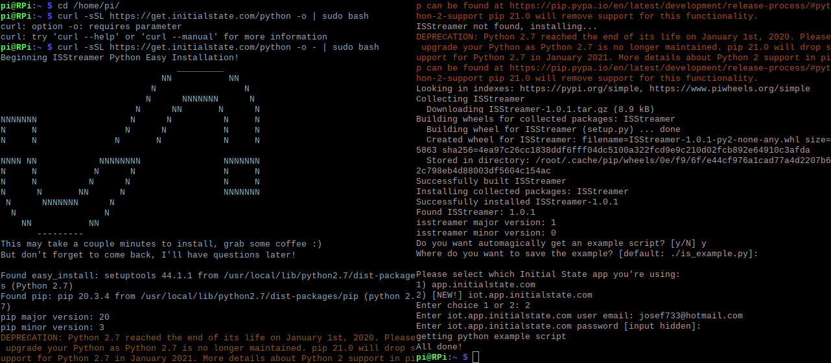
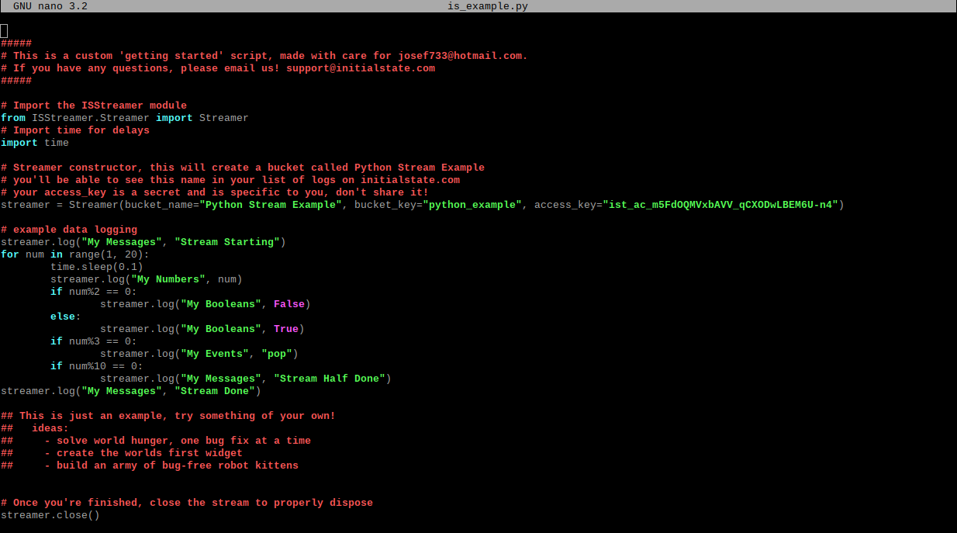
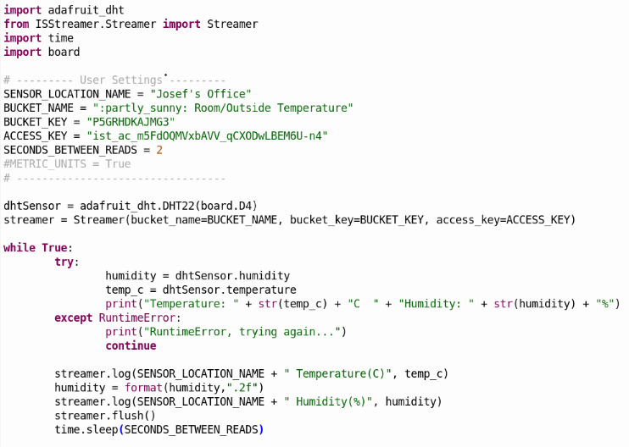
Software Implementation
Setting up Raspberry Pi OS
Enabling SSH
Writing the Python script
Setting up streaming service

Slide 8
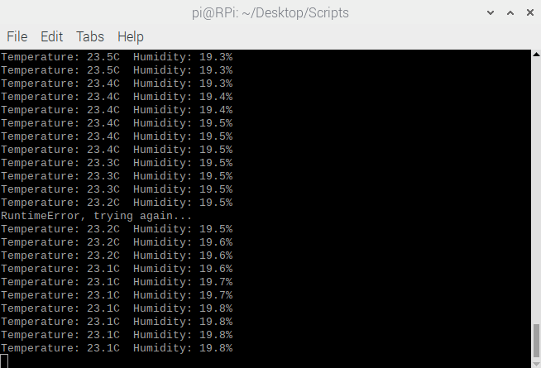
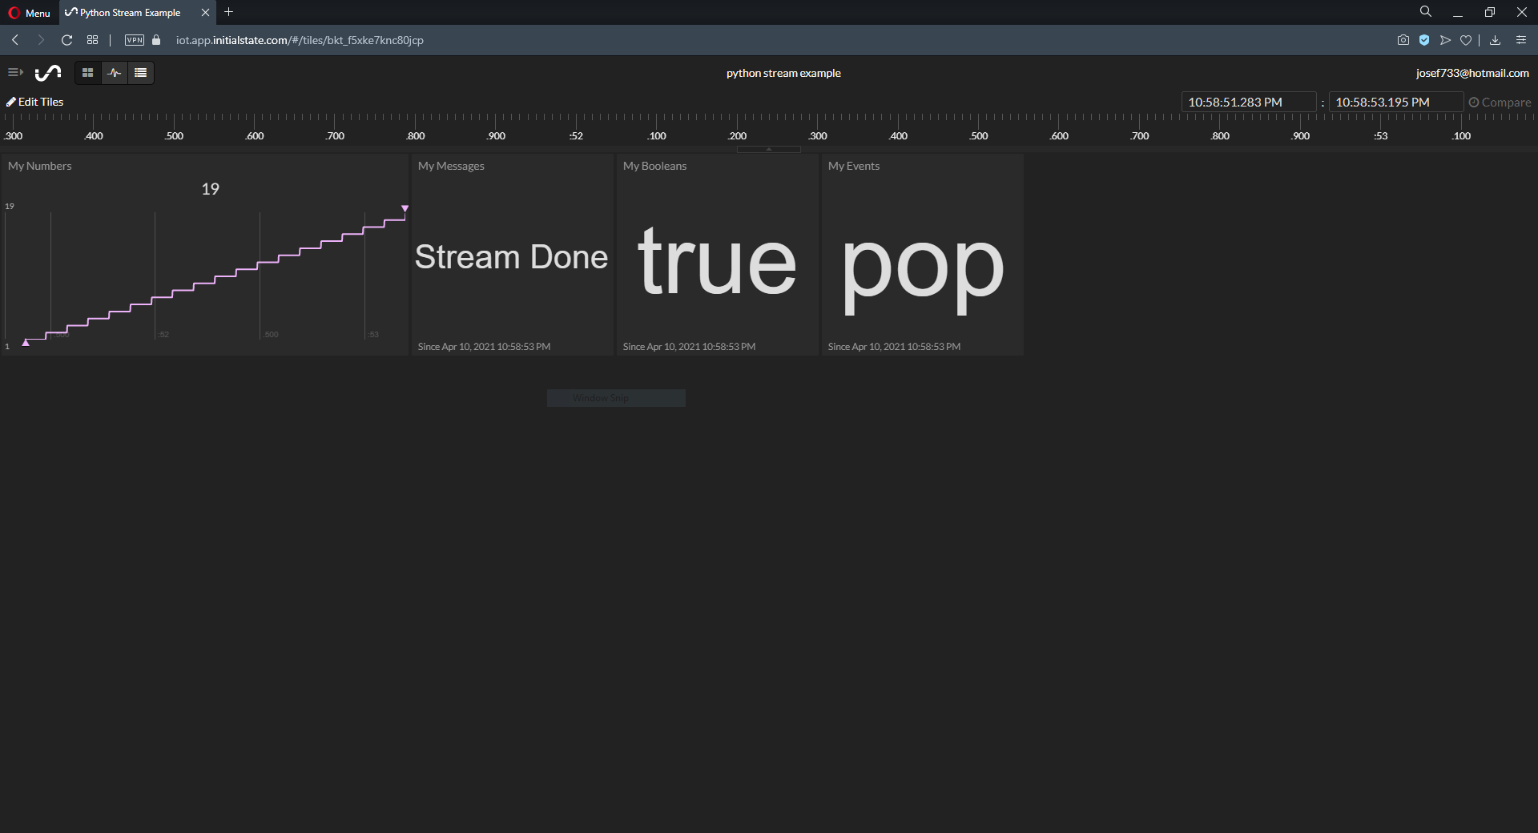
Results
Testing the script
Testing the example stream

Slide 9
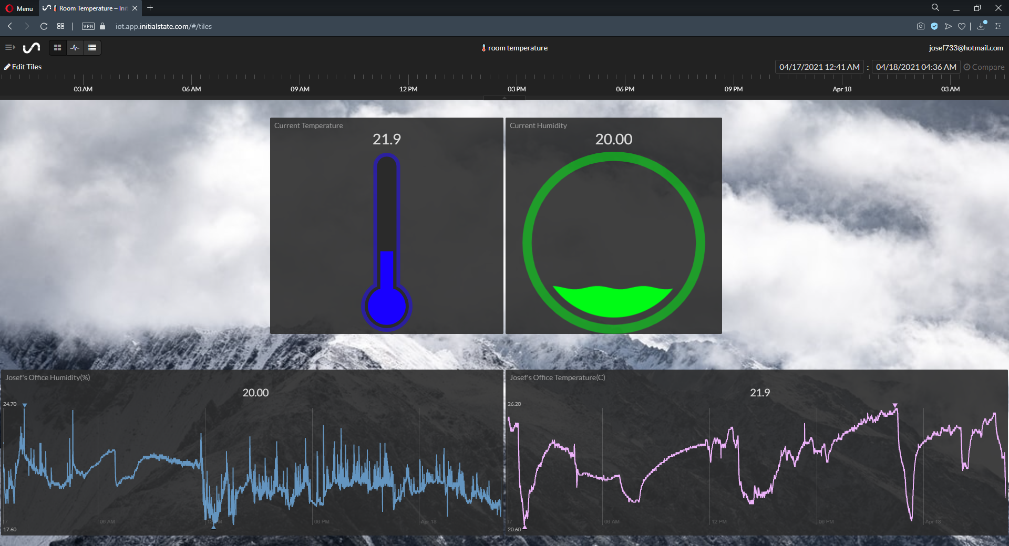
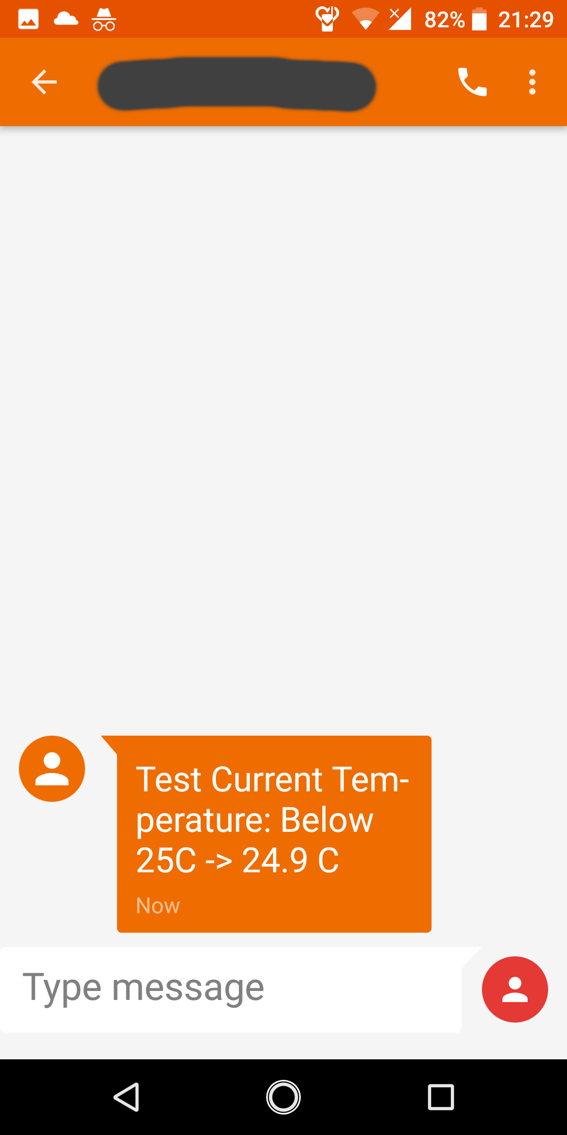
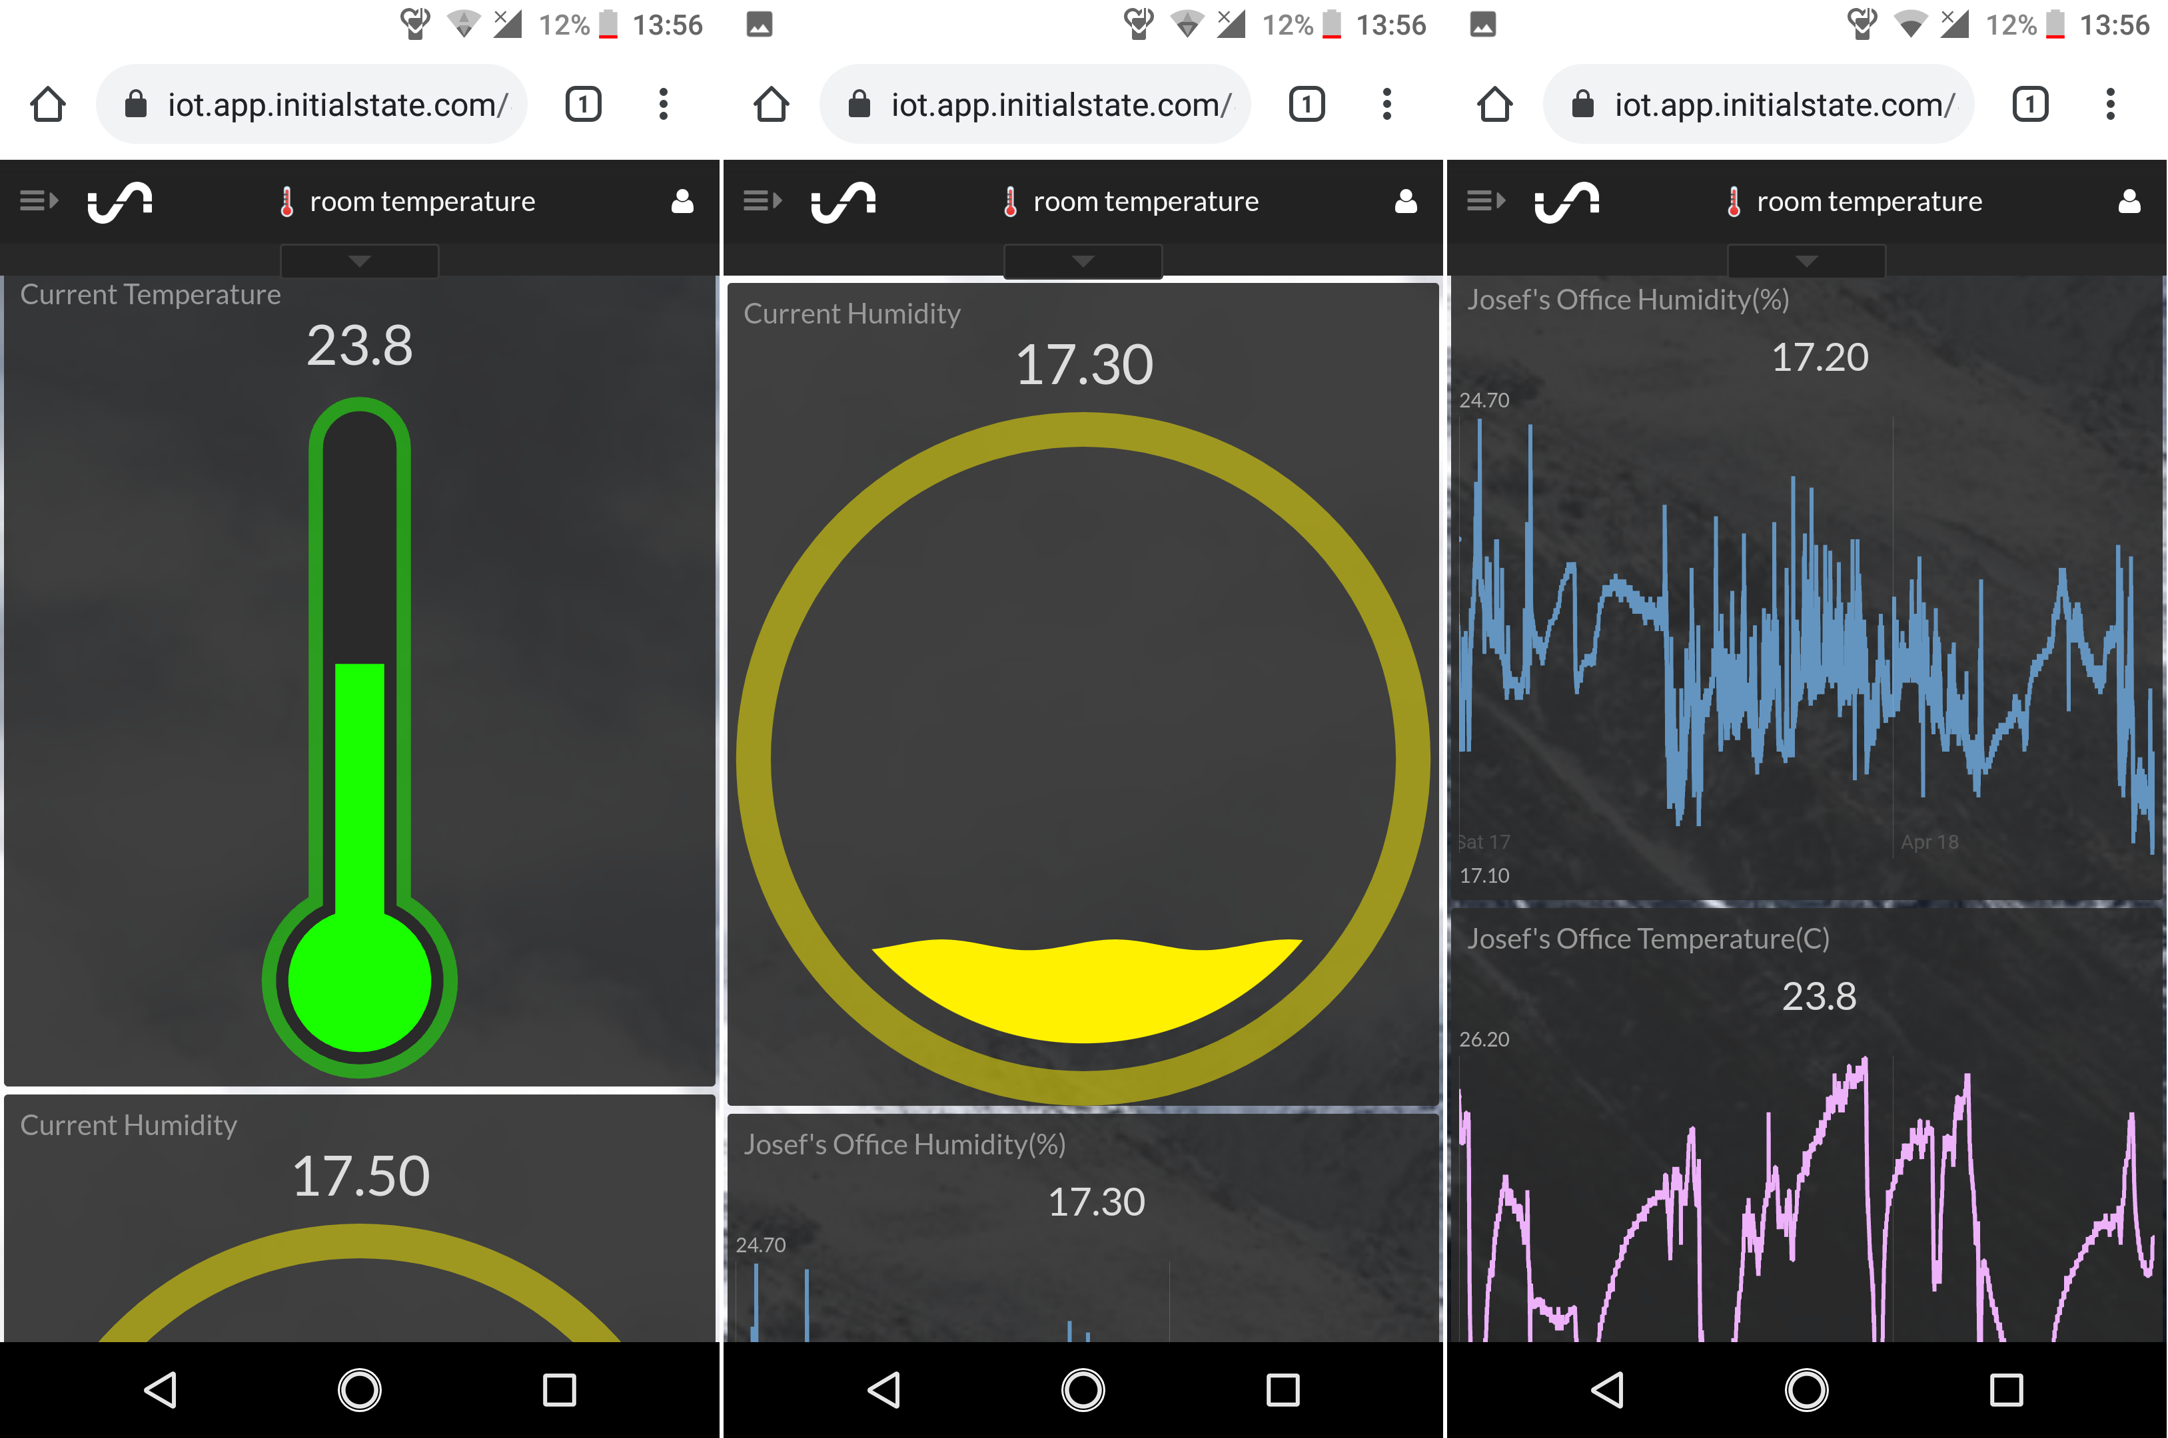
Results
Results on the web application
Functions on mobile
  incl. notifications
Minimal Errors

Slide 10
Conclusion
All systems functional
Works to a good standard
The first IOT solution at home

Slide 11
Future Improvements & Considerations
Temperature indicator light
LED hardware readout
Cosmetic Improvements
Rpi Model 4 Overkill

